Slide 1


XPRESSPASS
Lakshmi Narain College of Technology & Science, Bhopal
Submitted as 3rd year Minor Project to T&P Department
By
Harshwardhan Agrawal {0157CS161072}
Nitin Pathak {0157CS161104}
Prashiksha Jain {0157CS161117}
Rahul Saine {0157CS161129}
Branch - C.S.E. LNCT&S

Slide 2
Introduction
XPRESSPASS is a desktop application, designed to issue and validate the Gate Pass generating mechanism of an Institution.
It provides an over all secured way of issuing gate pass which can be tracked at various levels.

Slide 3
Problem
Current scenario of the Gate Pass mechanism involves manual receipt generation. This might involve unauthorized use of passes.
The current system involves static implementation in which the supreme authority has no control over the ongoing process, leading to questionable situations.
Future analysis of data has no outcome.

Slide 4
Idea
XPRESSPASS is an application which will perform the task of pass generation, validation and data organization in an efficient manner, controlled by authority.
Views:
Administrator
Head of Department
Student
Security

Slide 5
Features
Administrator
Increase/decrease daily pass allowance
View all passes generated on the basis of date/time, department, etc.
Communication between Administrator and H.O.D.
Remove/view details of H.O.D.
Head of Department
Generate gate pass
Verify gate pass of respective department
View all passes generated

Slide 6
Features
Student
Search student profile
Generate pass-id
Security
This is the checkpoint for students’ exit. Exit time is automatically updated.
XPRESSPASS
Valid only for 15 minutes
Contains student’s information

Slide 7
Technology / Tools used
Java SE
Oracle DataBase
Netbeans IDE
Local Area Network

Slide 8
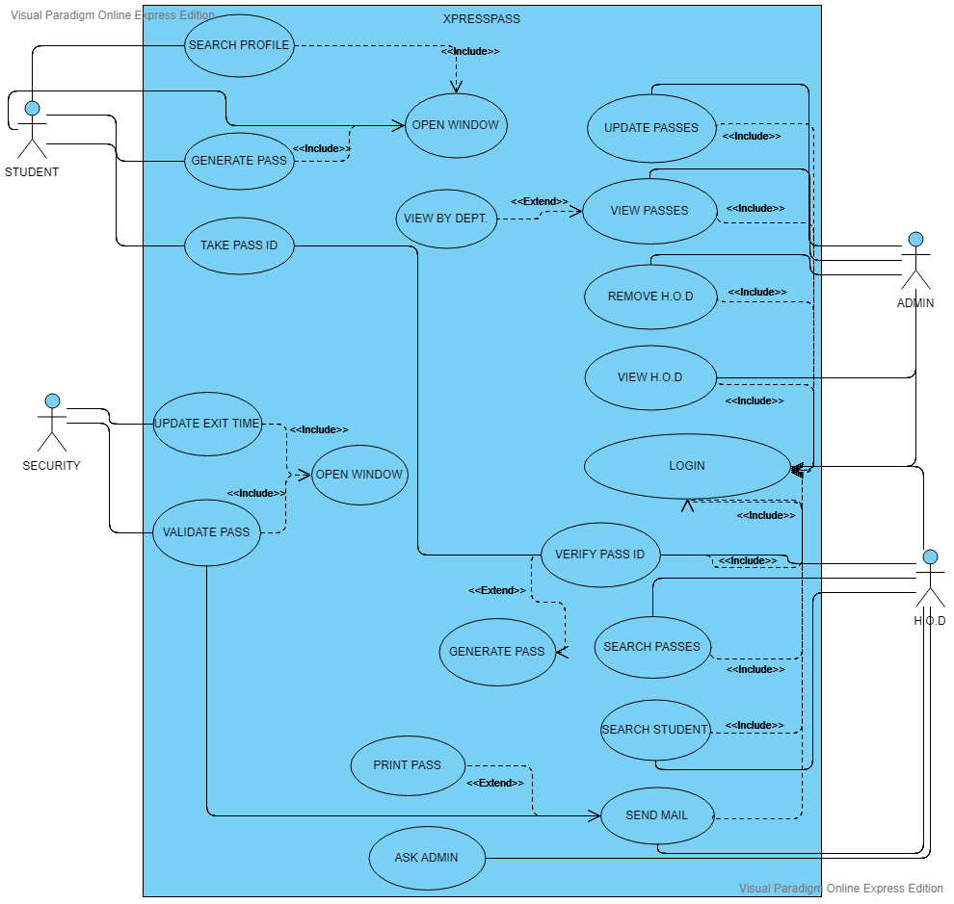
USE CASE DIAGRAM

Slide 9
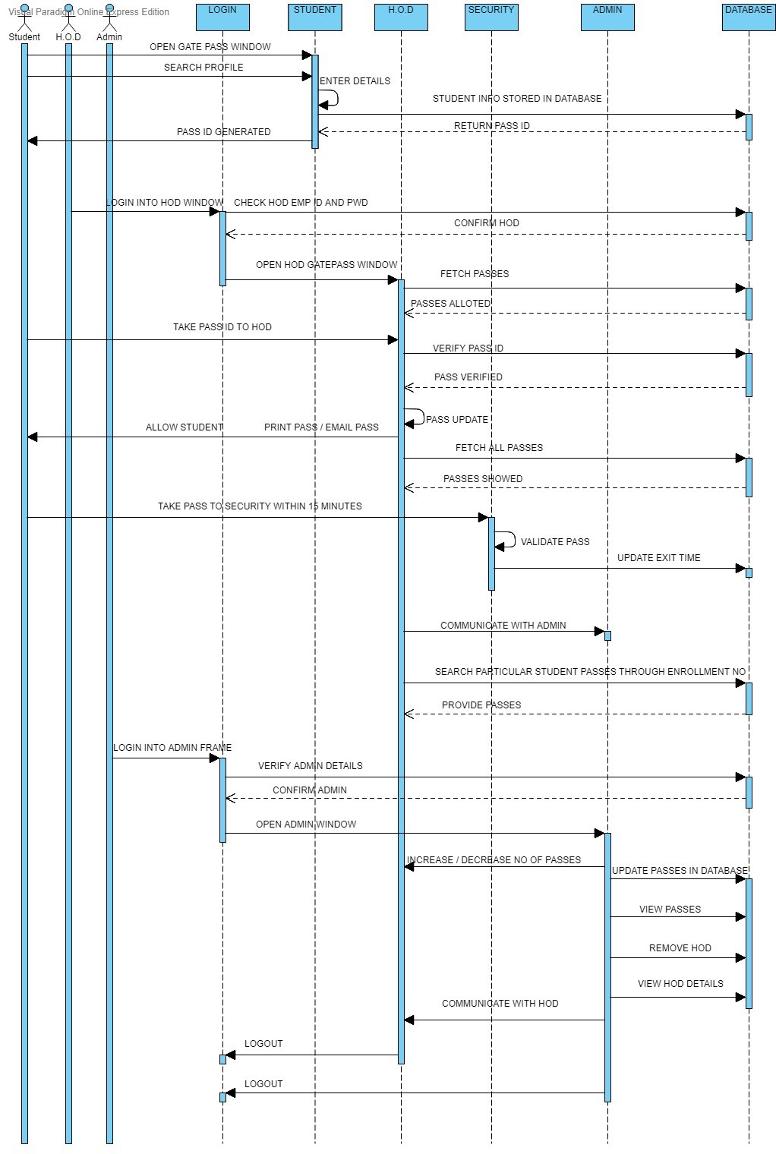
SEQUENCE DIAGRAM

Slide 10
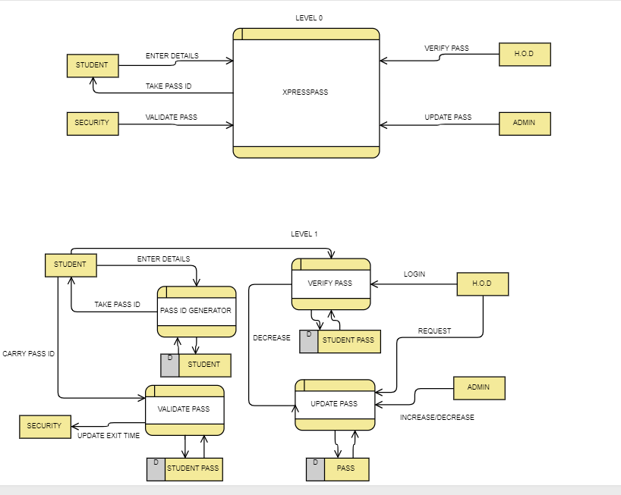
DATA FLOW DIAGRAM

Slide 11
Limitations
This is a desktop application and hence it can work in a local area.
It will take some time in mail sending feature.
Future Scope
XPRESSPASS can be converted to a web/mobile application for a
wider reach.

Slide 12
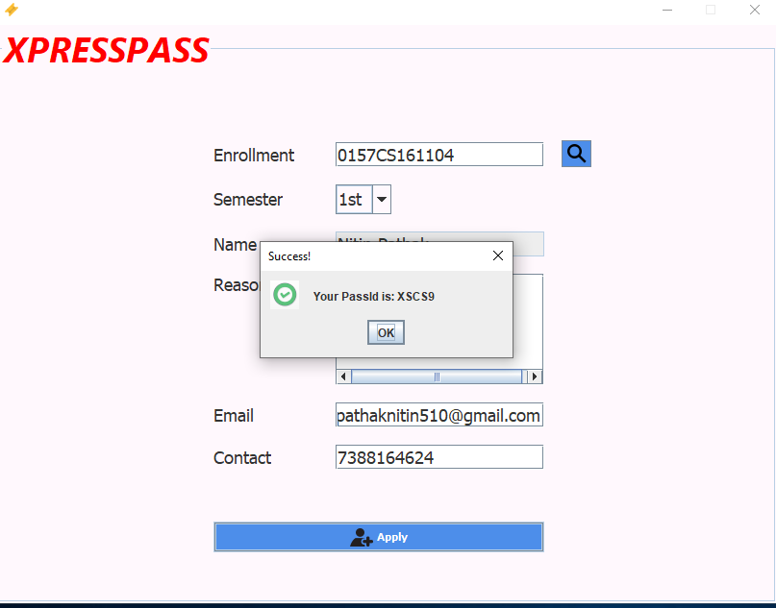
SCREENSHOTS
STUDENT END-
SEARCH PROFILE
ENTER STUDENT DETAILS

Slide 13
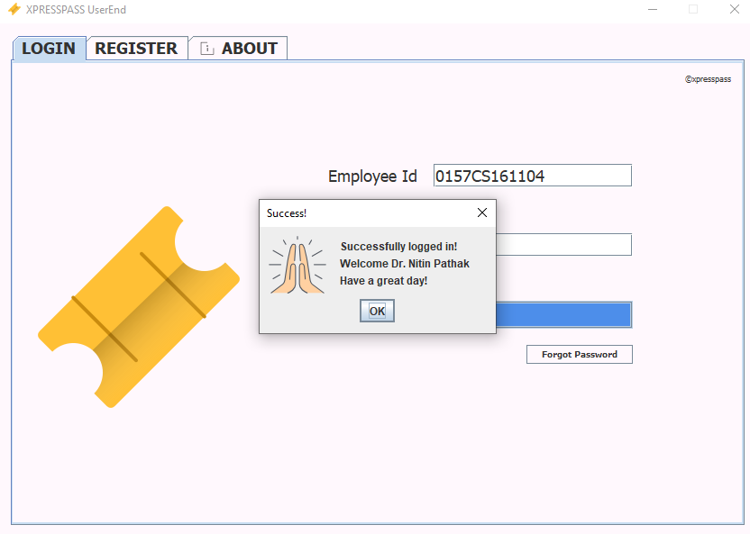
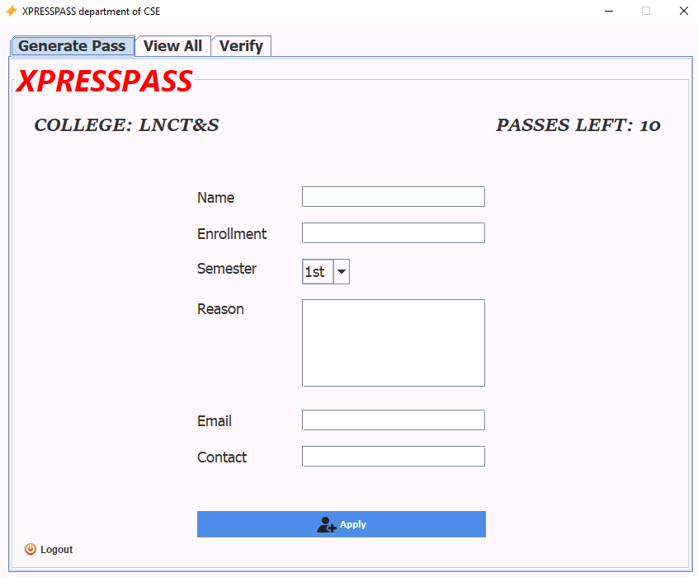
HOD END- (LOGIN AND LOGGED IN VIEW)

Slide 14
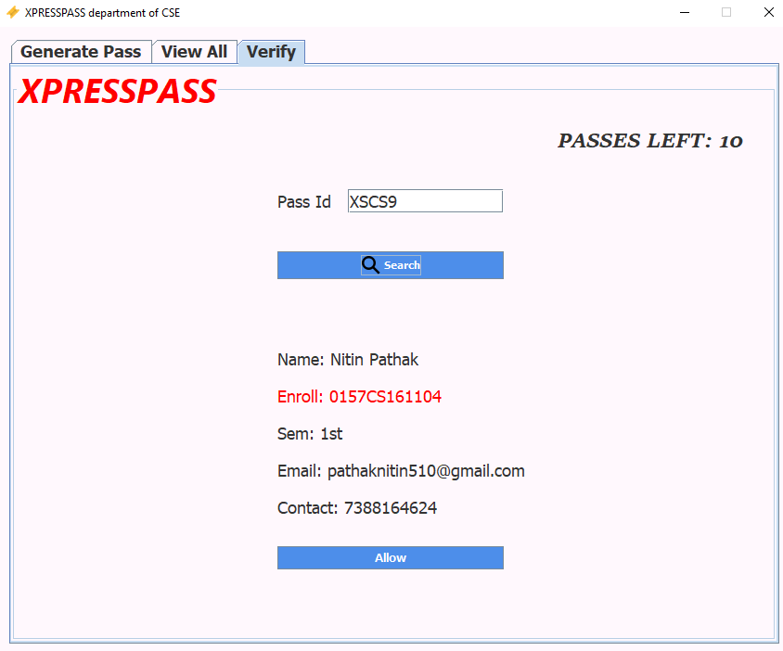
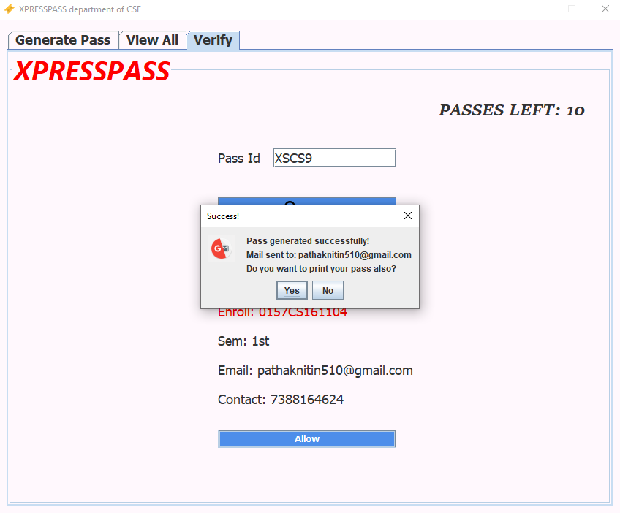
HOD END- (VERIFY PASS AND GENERATE PASS)

Slide 15
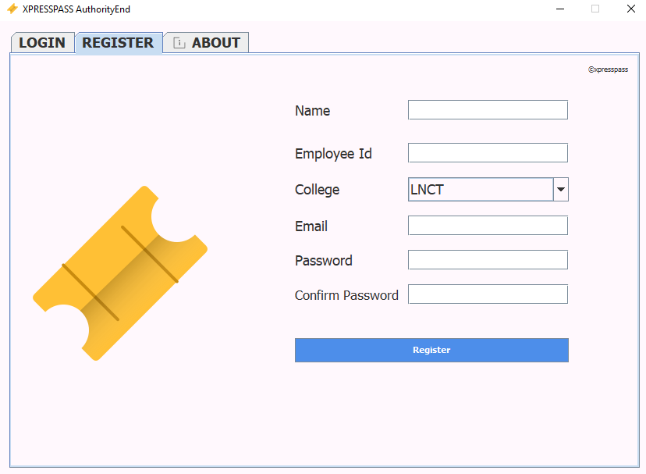
ADMIN END- (LOGIN AND REGISTER)

Slide 16
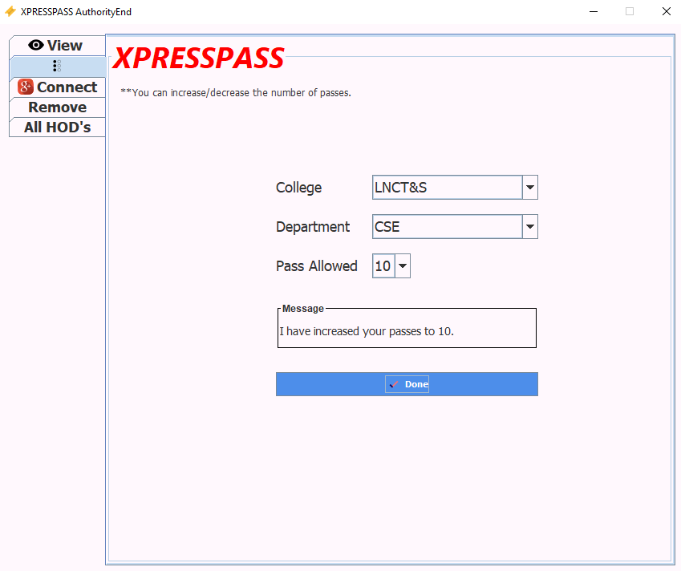
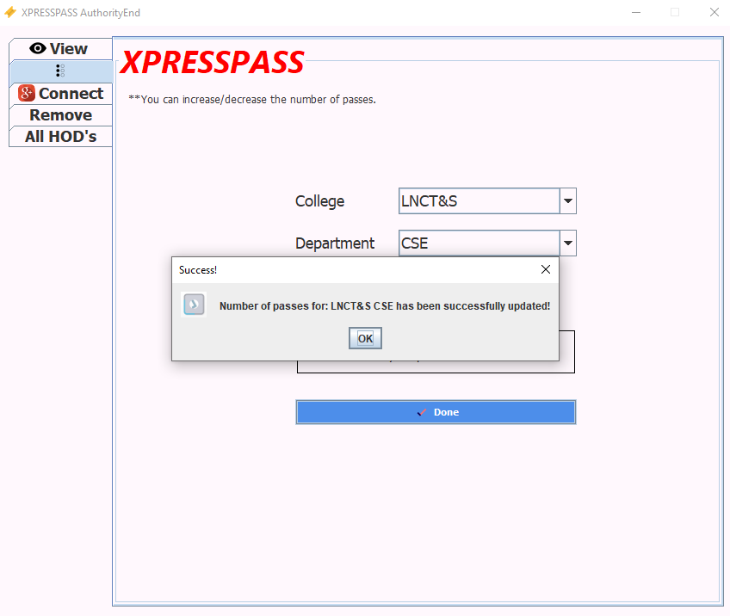
ADMIN END-(UPDATE NO. OF PASSES)

Slide 17
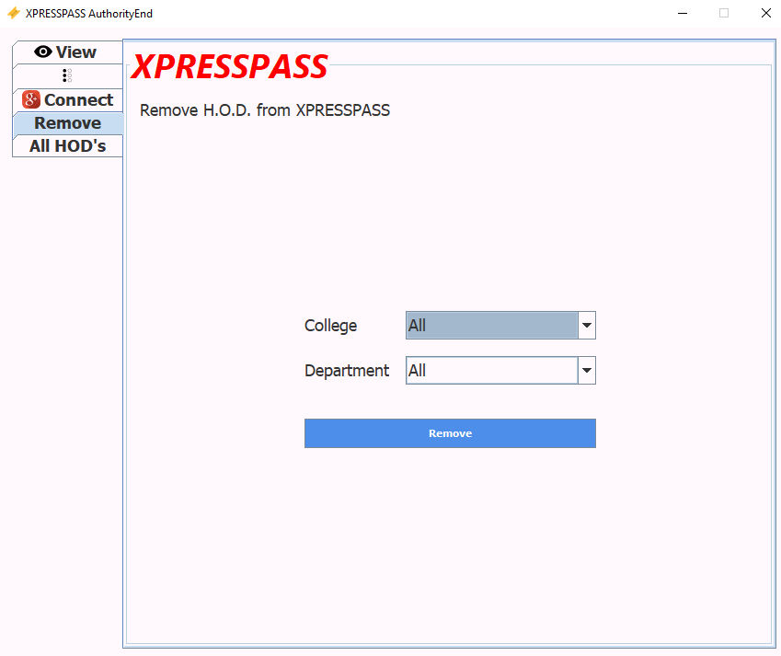
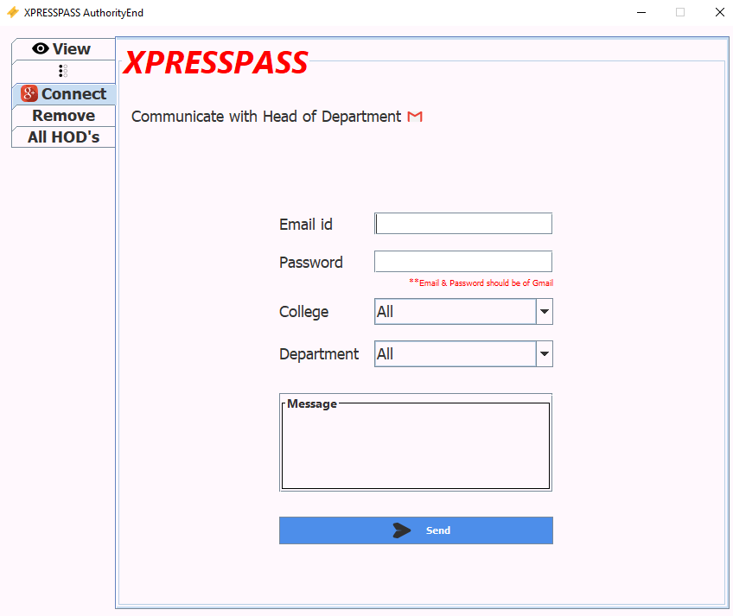
ADMIN END-(REMOVE HOD AND COMMUNICATE WITH HOD)

Slide 18
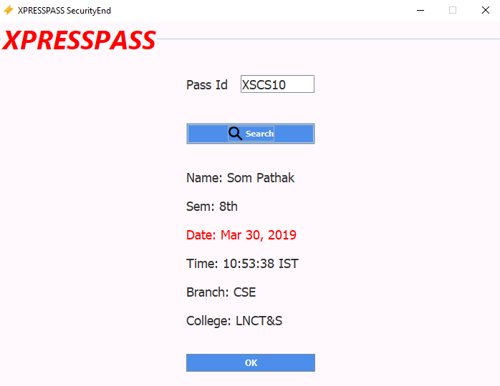
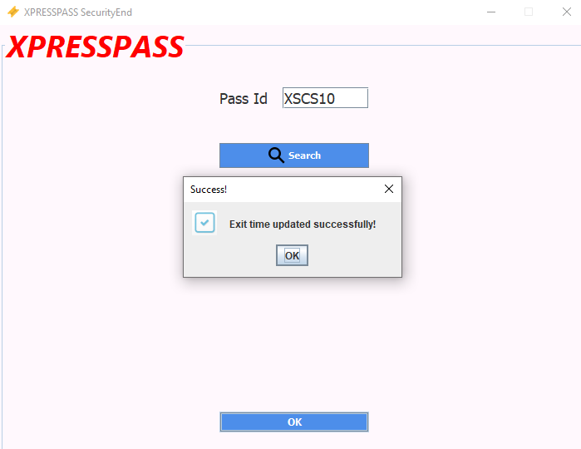
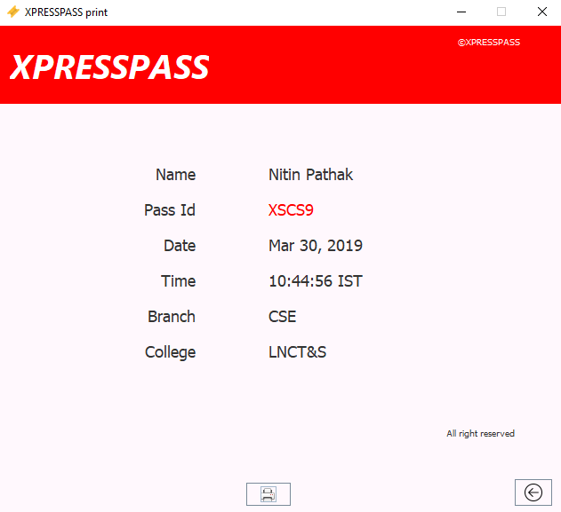
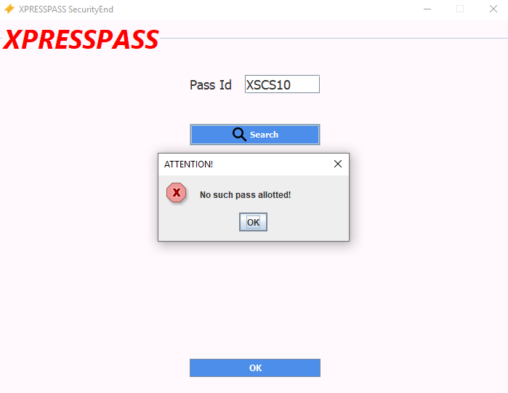
SECURITY END-(VALIDATING PASS AND UPDATING EXIT TIME)

Slide 19
Thank You

